Slide 1

GDPR – Journey to compliance
Lorraine Mills

Slide 2
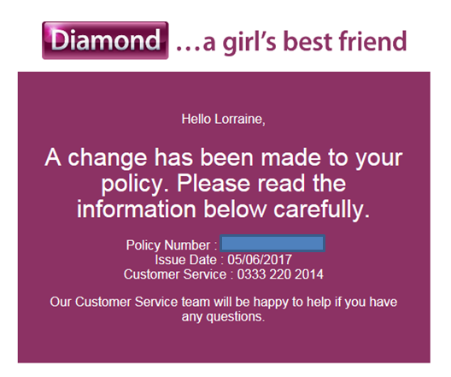
Do we know DPA?
Notes:
Background to the email – named drivers on policy

Slide 3
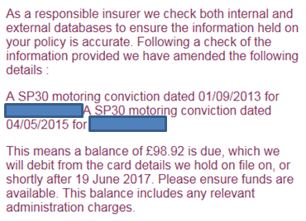
Do we know DPA?
Notes:
Details of named driver with convictions – one of which is not accurate.
Source of information cannot be confirmed as only available for 48 hours after the use of internet comparison website.

Slide 4
Can you spot the breaches?
The use of inaccurate information which they advised couldn’t be completely removed from the file and unable to advise the source used.
The information was sent using a hotmail e-mail – which is an unsecured format.
The data involved wasn’t mine – therefore it should never have been sent to me.

Slide 5

The Brexit Issue

Slide 6

The Brexit Issue
GDPR adopted by EU Council and Parliament April 2016.
Takes effect in every EU member state May 2018.
UK Government raised bill in parliament for new Data Protection Act to replace DPA (1998).
Possibility this may be replaced January 2018.
Notes:
There is no issue!
GDPR principles will apply to all countries especially those outside the EU. Countries will need to have in place legislation which meets the requirements specified in the GDPR.
The new DPA will cover this.

Slide 7

Six principles of GDPR

Slide 8
Six principles of GDPR
Personal data must be processed lawfully, fairly and transparently.
Personal data can only be collected for specified, explicit and legitimate purposes.
Personal data must be adequate, relevant and limited to what is necessary for processing.
Notes:
The focus of the legislation has really concentrated on personal data

Slide 9
Six principles of GDPR
Personal data must be accurate and kept up to date.
Personal data must be kept in a form such that the data subject can be identified only as long as is necessary for processing.
Personal data must be processed in a manner that ensures its security.

Slide 10

DPA vs. GDPR – Clear Consent
DPA negative opt-in allowed.
GDPR positive opt-in compulsory.
In order to store personal data, a company must have evidence that the data subject has given specific permission.
Notes:
If your company holds personal data the process of collecting permission needs to start immediately

Slide 11

DPA vs. GDPR – Right to be forgotten
Data subjects have the right to have any data held about them erased.
This must be automatic if data subject withdraws consent.
Data controller must make reasonable attempts to delete any data held that is public.
Notes:
Examples of new articles, pictures.
Pictures of children when they turn 16 – parental consent is being questioned across Europe.

Slide 12

DPA vs. GDPR – Data portability
Data subjects can request a copy of all data held on them.
Nominal fee now cancelled.
Data subject can request all data held on them to be transmitted to a different data controller.
Notes:
In the event of customer cancelling a contract and moving to a competitor – Gas, Electric, Phones

Slide 13

Sanctions

Slide 14

Sanctions
There are two layers of fines.
Lower rate is the greatest of €10 million and 2% global annual turnover.
Higher rate is the greatest of €20 million and 4% global annual turnover.
Fines greater than a € billion are noted as being possible.
Notes:
Two types of fines are for Personal Data Breaches (PDBs) and for Administration breaches
DPA max fines £500,000
PDBs – data subject only needs to show ‘harm’ rather than actual financial loss, much lower evidential burden than DPA.

Slide 15

Data policies – Where to start
Notes:
DPIA – documents how, what data, what consents, what processing and what type of security, ie how you comply with the GDPR.
DPCR – every two years

Slide 16
Data policies – Where to start
Understand your data: where is it stored and how is it used?
Data protection impact assessment (DPIA).
Every two years Data Protection Compliance Review (DPCR).
Policies have to be amended to show the processing involved in storing data.
Notes:
DPIA – documents how, what data, what consents, what processing and what type of security, ie how you comply with the GDPR.
DPCR – every two years

Slide 17

Marketing and website considerations
Notes:
GDPR marketing consent must be explicit:
- time limited opt-in
In plain language (age appropriate Data Subject)
With the requirement that the data subject is able to opt-out of profiling and object to the results of profiling
Burden of proof to show consent has shifted to the data controller and the organisation

Slide 18
Marketing and website considerations
All data subjects will have to have opted in to their data being stored.
Changes to the cookies law.
Amendments to opt in boxes on web pages.
If a data subject doesn’t consent then there should be no detriment to the service provided.
Notes:
GDPR marketing consent must be explicit:
- time limited opt-in
In plain language (age appropriate Data Subject)
With the requirement that the data subject is able to opt-out of profiling and object to the results of profiling
Burden of proof to show consent has shifted to the data controller and the organisation

Slide 19

Breach notifications to the ICO
Data breaches have to be reported to the ICO within 72 hours or less.
Data subjects have to be notified of any breach of their data.
Notes:
This could be hard to meet if your company is not running and network security analytics and therefore with regards to fines for this we will need to wait and see how strict.
Once a breach is identified notification has to be issued to ICO within 72 hours

Slide 20
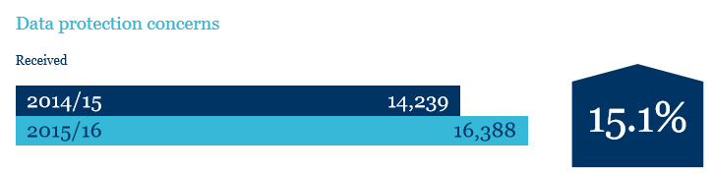
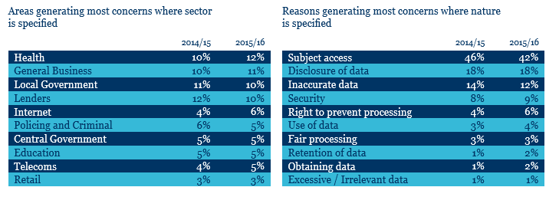
ICO data 2015/16
Notes:
Data and graphs from ICO reports regarding fines for media/charity organisations

Slide 21
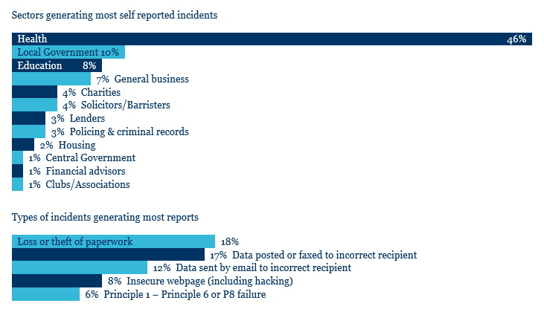
ICO data 2015/16

Slide 22

Recommended reading
Notes:
Preparing for the General Data Protection Regulation – 12 steps to take now ICO website

Slide 23
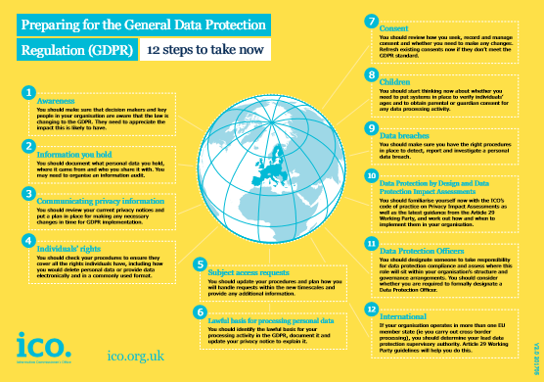
ICO – 12 Steps Guide
Notes:
1 Awareness
2 Information you hold
3 Communicating privacy information
4 Individual’s rights
5 Subject access requests
6 Lawful basis for processing personal data
7 Consent
8 Children
9 Data breaches
10 Data protection by design and data protection impact assessments

Slide 24




Contact us
NVT Group
Call us on 01698 749 000
E-mail: info@nvt.co.uk
Visit our website: www.nvtgroup.co.uk
@nvtgroup
facebook.com/nvtgroup
linkedin.com/company/nvt-group
Notes:
Preparing for the General Data Protection Regulation – 12 steps to take now ICO website – get picture

